Slide 1

TWMS Mobile SSO Login – User Guide

Slide 2
TWMS Mobile SSO Login feature
TWMS Mobile SSO Login on Australia server using Microsoft Account
TWMS Mobile SSO Login on Australia server using Google / Gmail Account
TWMS Mobile SSO Login on United State server using Microsoft Account
TWMS Mobile SSO Login on United State server using Google / Gmail Account

Slide 3
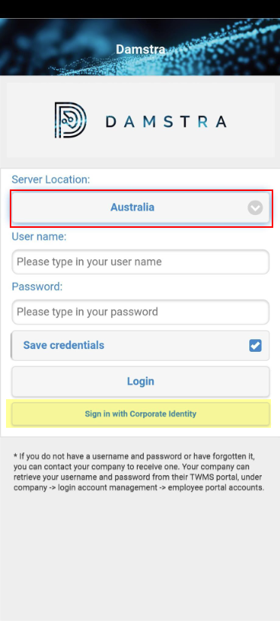
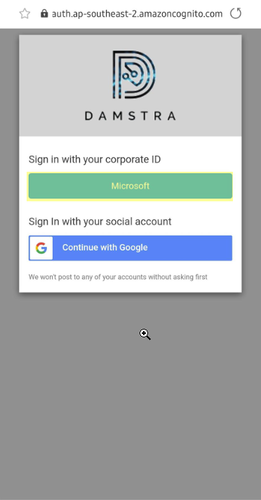
TWMS Mobile SSO Login on Australia server using Microsoft Account
1. Open your TWMS Mobile App using Android/IOS mobile phone
3. Select “Sign in with your Corporate ID” Microsoft button
2. Select “Australia” as Server location and click on “Sign in with Corporate Identity”

Slide 4
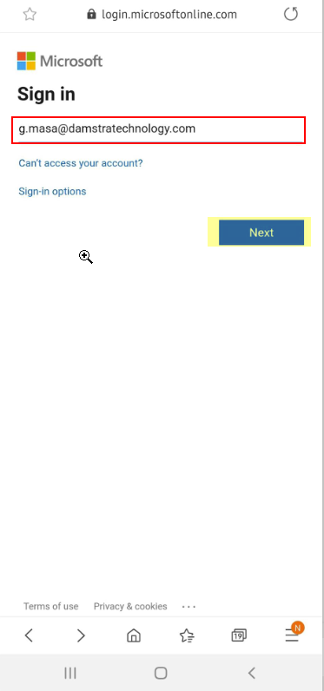
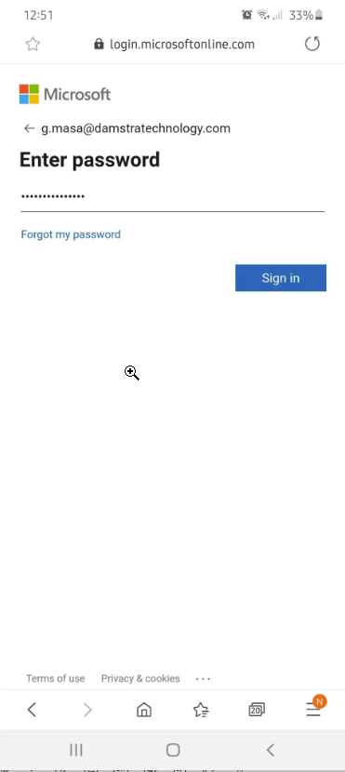
TWMS Mobile SSO Login on Australia server using Microsoft Account
1. Input your Corporate/Microsoft account and tap on “Next” button
2. Input your Password and tap on “Sign” in button

Slide 5
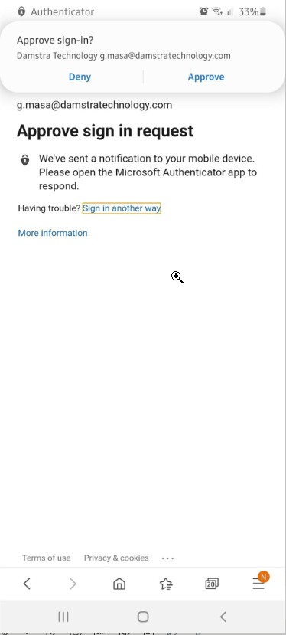
TWMS Mobile SSO Login on Australia server using Microsoft Account
1. Microsoft authentication will only display if it’s enabled on your corporate email account
Note: there are other way to authenticate your Microsoft user account

Slide 6
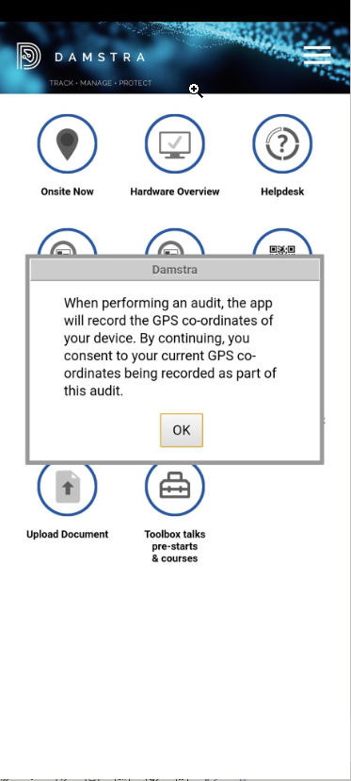
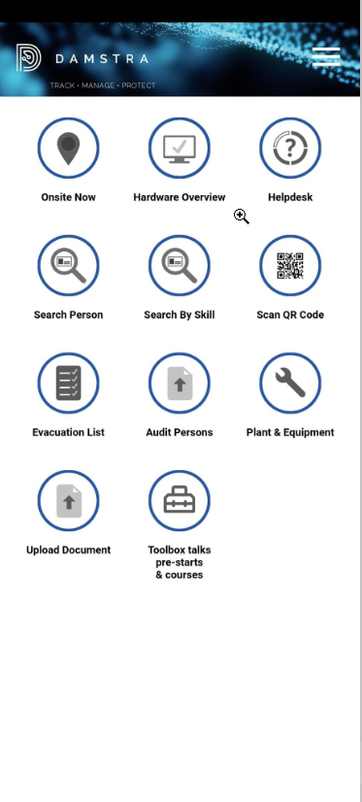
TWMS Mobile SSO Login on Australia server using Microsoft Account
1. Notification that the application use a GPS co-ordinates
2. Tapping on OK button will close the Window and display the TWMS mobile app menus

Slide 7
TWMS Mobile SSO Login on Australia server using Google Account

Slide 8
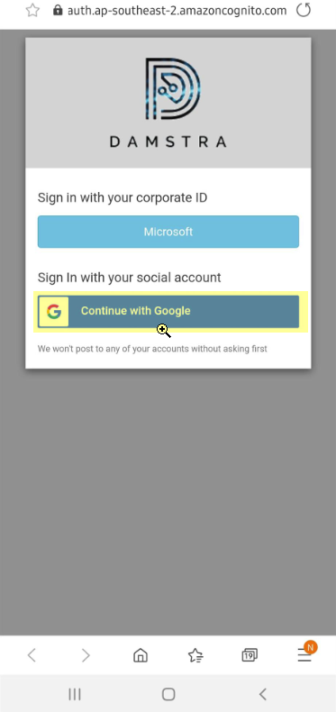
TWMS Mobile SSO Login on Australia server using Google Account
1. Open your TWMS Mobile App using Android/IOS mobile phone
3. Select “Sign in with your social account” Continue with Google button
2. Select “Australia” as Server location and click on “Sign in with Corporate Identity”

Slide 9
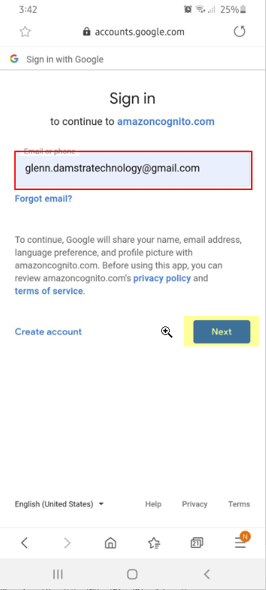
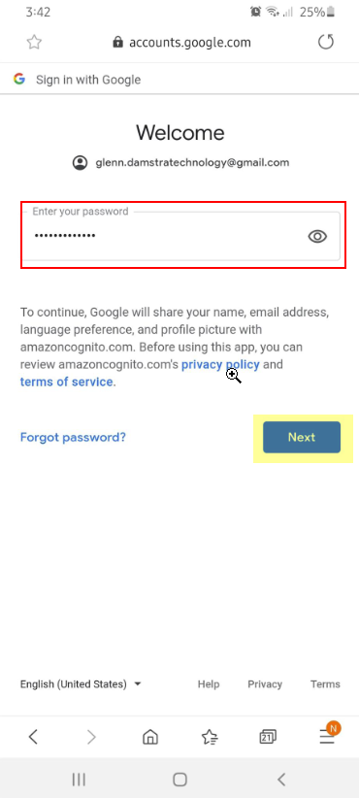
TWMS Mobile SSO Login on Australia server using Google Account
1. Input your Gmail account and tap on “Next” button
2. Input your Password and tap on “Sign” in button

Slide 10
TWMS Mobile SSO Login on Australia server using Google Account
1. Notification that the application use a GPS co-ordinates
2. Tapping on OK button will close the Window and display the TWMS mobile app menus

Slide 11
TWMS Mobile SSO Login on United State server using Microsoft Account

Slide 12
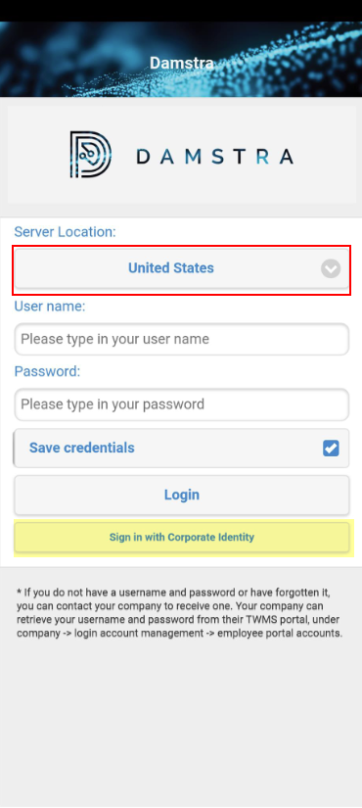
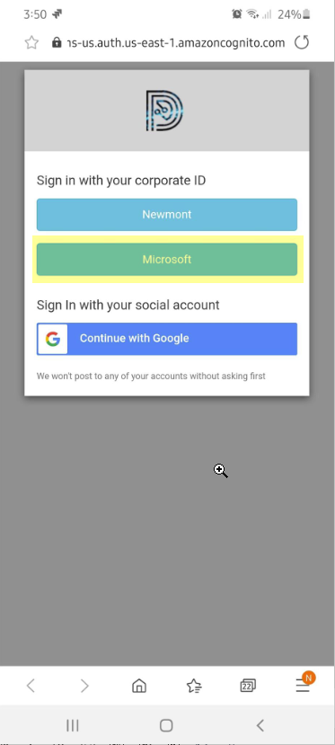
TWMS Mobile SSO Login on United State server using Microsoft Account
1. Open your TWMS Mobile App using Android/IOS mobile phone
3. Select “Sign in with your Corporate ID” Microsoft button
2. Select “United State” as Server location and click on “Sign in with Corporate Identity”

Slide 13
TWMS Mobile SSO Login on United State server using Microsoft Account
1. Input your Corporate/Microsoft account and tap on “Next” button
2. Input your Password and tap on “Sign” in button

Slide 14
TWMS Mobile SSO Login on United State server using Microsoft Account
1. Microsoft authentication will only display if it’s enabled on your corporate email account
Note: there are other way to authenticate your Microsoft user account

Slide 15
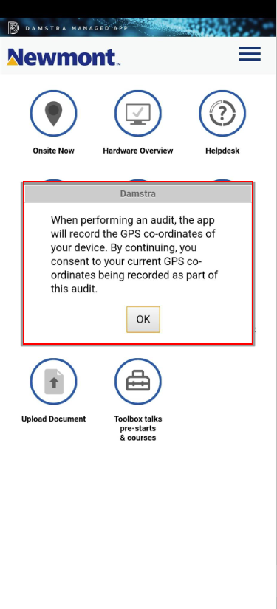
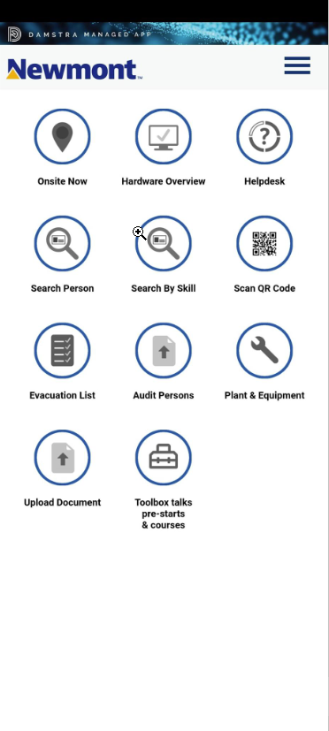
TWMS Mobile SSO Login on United State server using Microsoft Account
1. Notification that the application use a GPS co-ordinates
2. Tapping on OK button will close the Window and display the TWMS mobile app menus

Slide 16
TWMS Mobile SSO Login on United State server using Google Account

Slide 17
TWMS Mobile SSO Login on United State server using Google Account
1. Open your TWMS Mobile App using Android/IOS mobile phone
1. Select “Sign in with your social account” Continue with Google button
2. Select “United State” as Server location and click on “Sign in with Corporate Identity”

Slide 18
TWMS Mobile SSO Login on United State server using Google Account
1. Input your Gmail account and tap on “Next” button
2. Input your Password and tap on “Sign” in button

Slide 19
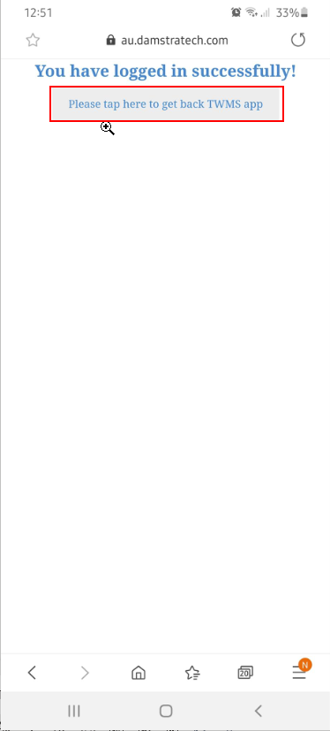
TWMS Mobile SSO Login on United State server using Google Account
2. Login Successfully confirmation message, tap on “Please tap here to get back TWMS app”

Slide 20
TWMS Mobile SSO Login on United State server using Google Account
1. Notification that the application used a GPS co-ordinates
2. Tapping on OK button will close the Window and display the TWMS mobile app menus

Slide 21


